Slide 1

PREDICTING HOUSE PRICE USING MACHINE LEARNING
PROJECT : HOUSE PRICE PREDICTION

Slide 2

House Price Prediction
Introduction:
The process of building a house price prediction model is a critical endeavor in the realm of real estate,finance,and property valuation accurately estimating the price of house is essential for buyers,sellers and investors to make informed decision .In this comprehensive guide we will continue to delve deeper into the construction of the robust house price prediction model by focusing on three fundamental components :feature selection ,model training and evaluation.
Feature selection is the process of identifying and selecting the most relevent features from a data set to improve the performance of the machine learning model.This is the important step in building a house price prediction model as it can help to reduce over fitting and improve the generalization ability of the model.
Model training is the process of feeding the selected features to a machine learning algorithm and allowing it to learn the relationship between the features and the target variable.Improve the generalization ability of the model .

Slide 3
Model training is the process of feeding the selected features to a machine learning algorithm and allowing it to learn the relationship between the features and the target variable(i.e.,house price).once the model is trained,it can be used to predict the house prices of new houses,given their features.
Model evoluation is the process of assessing the performance of a trained machine learning model on a held-out test set.This is important to ensure that the model is generalizing well and that it is not overfitting the training data

Slide 4
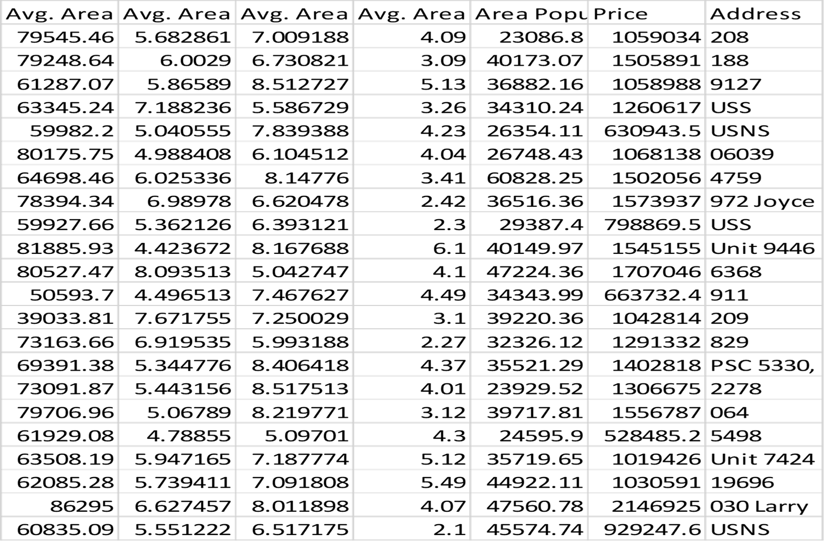
Given Data set:

Slide 5
Overview of the process:
The following is an overview of the process of building a house price prediction model
by feature selection,model training and evaluation.
1.Prepare the Data: This includes cleaning the Data,removing outliers,and handling missing values.
2.Perform feature selection: This can be done using a variety of methods,such as correlation analysis,information gain,and recursive feature elimination.
3.Train the model: There are many different machine learning algorithm that can be used for house price prediction some popular choices include linear regression,random forests,and gradient boosting machines.
4.Evaluate the model: This can be done by calculating the mean squared error(MSE)or the root mean squared error(RMSE)of the model’s prediction on the held-out test set.
5.Deploy the model: Once the model has been evaluated and found to be performing well,it can bedeployed to production so that it can be used to predict the house prices of new houses

Slide 6
PROCEDURE:
Feature selection:
Identify the target variable: This is the variable that you want to predict,such as house price.
2.Explore the Data: This will help you to understand the relationships between the different features and the target variable .You can use data visualization and correlation analysis to identify features that are highly correlated with the target variable.
3.Remove redundant features: If two features are highly correlated with each other ,then you can remove one of the features as they are used to predict the house price of new houses.

Slide 7
Feature selection:
Feature selection is a crucial step in the process of building machine learning models. It involves selecting the most relevant features or variables from the dataset to be used as input for the model. The goal of feature selection is to improve the performance of the model by reducing overfitting, decreasing the computational cost, and improving the model's interpretability.
import pandas as pd
from sklearn.feature_selection import SelectKBest, f_regression
from sklearn.model_selection import train_test_split
from sklearn.linear_model import LinearRegression
from sklearn.metrics import mean_squared_error
Checking missing values:

Slide 8
# Import necessary libraries
import numpy as np
import pandas as pd
from sklearn.datasets import load_boston
from sklearn.model_selection import train_test_split
from sklearn.linear_model import LinearRegression
from sklearn.metrics import mean_squared_error, r2_score
# Load the Boston Housing dataset
boston = load_boston()
data = pd.DataFrame(boston.data, columns=boston.feature_names)
data['PRICE'] = boston.target
# Split data into features (X) and target (y)
X = data.drop('PRICE', axis=1)
y = data['PRICE']
# Split data into training and testing sets
X_train, X_test, y_train, y_test = train_test_split(X, y, test_size=0.2, random_state=42)

Slide 9
# Train a linear regression model
model = LinearRegression()
model.fit(X_train, y_train)
# Predict house prices on the test set
y_pred = model.predict(X_test)
# Evaluate the model
mse = mean_squared_error(y_test, y_pred)
r2 = r2_score(y_test, y_pred)
print(f"Mean Squared Error (MSE): {mse}")
print(f"R-squared (R2) Score: {r2}")
# Optional: Print the coefficients for each feature
coefficients = pd.DataFrame({'Feature': X.columns, 'Coefficient': model.coef_})
print(coefficients)
# Optionally, you can save the model for future use
# import joblib
# joblib.dump(model, 'house_price_model.pkl')

Slide 10
Model training:
Training a house price prediction model involves the process of fitting a machine learning algorithm to a dataset containing features related to houses (e.g., number of bedrooms, square footage, location, etc.) and their corresponding prices.
model = LinearRegression()
# Import necessary libraries
import numpy as np
import matplotlib.pyplot as plt
from sklearn.linear_model import LinearRegression
from sklearn.model_selection import train_test_split
from sklearn.metrics import mean_squared_error
# Generate some example data
np.random.seed(0)
X = np.random.rand(100, 1) # Independent variable
y = 2 * X.squeeze() + np.random.randn(100) # Dependent variable with some random noise

Slide 11
# Initialize the Linear Regression model
model = LinearRegression()
# Train the model
model.fit(X_train, y_train)
# Predict using the test set
y_pred = model.predict(X_test)
# Calculate Mean Squared Error (MSE)
mse = mean_squared_error(y_test, y_pred)
print(f"Mean Squared Error (MSE): {mse}")
# Visualize the results
plt.scatter(X_test, y_test, color='blue', label='Actual')
plt.plot(X_test, y_pred, color='red', label='Predicted')
plt.xlabel('X')
plt.ylabel('y')
plt.legend()
plt.show()

Slide 12
Redge
Regression:
# Import necessary libraries
from sklearn.linear_model import Ridge
from sklearn.model_selection import train_test_split
from sklearn.metrics import mean_squared_error
import numpy as np
# Assuming you have X (features) and y (target variable) ready
# Split data into training and testing sets
X_train, X_test, y_train, y_test = train_test_split(X, y, test_size=0.2, random_state=42)
# Initialize the Ridge regression model with alpha value
alpha = 1.0 # You can adjust this hyperparameter
ridge_model = Ridge(alpha=alpha)
# Train the model
ridge_model.fit(X_train, y_train)
# Predict house prices on the test set
y_pred = ridge_model.predict(X_test)
# Evaluate the model using Mean Squared Error (MSE)
mse = mean_squared_error(y_test, y_pred)
print(f"Mean Squared Error (MSE): {mse}")

Slide 13
Lasso
Regression:
# Import necessary libraries
from sklearn.linear_model import Lasso
from sklearn.model_selection import train_test_split
from sklearn.metrics import mean_squared_error
import numpy as np
# Assuming you have X (features) and y (target variable) ready
# Split data into training and testing sets
X_train, X_test, y_train, y_test = train_test_split(X, y, test_size=0.2, random_state=42)
# Initialize the Lasso regression model with alpha value
alpha = 1.0 # You can adjust this hyperparameter
lasso_model = Lasso(alpha=alpha)
# Train the model
lasso_model.fit(X_train, y_train)
# Predict house prices on the test set
y_pred = lasso_model.predict(X_test)
# Evaluate the model using Mean Squared Error (MSE)
mse = mean_squared_error(y_test, y_pred)
print(f"Mean Squared Error (MSE): {mse}")

Slide 14
# Import necessary libraries
from sklearn.linear_model import ElasticNet
from sklearn.model_selection import train_test_split
from sklearn.metrics import mean_squared_error
import numpy as np
# Assuming you have X (features) and y (target variable) ready
# Split data into training and testing sets
X_train, X_test, y_train, y_test = train_test_split(X, y, test_size=0.2, random_state=42)
# Initialize the Elastic Net regression model with alpha and l1_ratio values
alpha = 1.0 # You can adjust this hyperparameter
l1_ratio = 0.5 # You can adjust this hyperparameter (0.5 means equal L1 and L2 penalties)
elastic_net_model = ElasticNet(alpha=alpha, l1_ratio=l1_ratio)
# Train the model
elastic_net_model.fit(X_train, y_train)
# Predict house prices on the test set
y_pred = elastic_net_model.predict(X_test)
# Evaluate the model using Mean Squared Error (MSE)
mse = mean_squared_error(y_test, y_pred)
print(f"Mean Squared Error (MSE): {mse}")
Elastic net:

Slide 15
Support vector
Machine:
# Import necessary libraries
from sklearn import svm
from sklearn.model_selection import train_test_split
from sklearn.metrics import accuracy_score
# Generate some example data
# Assuming X contains your features and y contains corresponding labels (0 or 1 for binary classification)
# Make sure to replace X and y with your actual data
# Split the data into training and testing sets
X_train, X_test, y_train, y_test = train_test_split(X, y, test_size=0.2, random_state=42)
# Create an SVM classifier
clf = svm.SVC(kernel='linear') # You can choose different kernels like 'linear', 'poly', 'rbf', etc.
# Train the SVM classifier on the training data
clf.fit(X_train, y_train)
# Predict labels for the test set
y_pred = clf.predict(X_test)
# Calculate accuracy
accuracy = accuracy_score(y_test, y_pred)

Slide 16
Evaluation of Predicted Data:
IN[1]:
plt.figure(figsize=(12,6))
plt.plot(np.arange(len(Y_test)), Y_test, label='Actual Trend')
plt.plot(np.arange(len(Y_test)), Prediction1, label='Predicted Trend')
plt.xlabel('Data')
plt.ylabel('Trend')
plt.legend()
plt.title('Actual vs Predicted')
OUT[1]:
Text(0.5, 1.0, 'Actual vs Predicted')

Slide 17
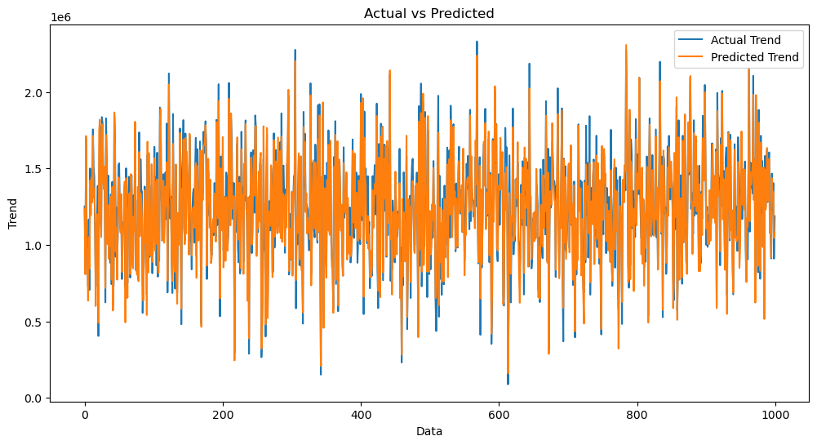
IN[2]:
sns.histplot((Y_test-Prediction1), bins=50)
OUT[2]:
<Axes: xlabel='Price', ylabel='Count'>

Slide 18
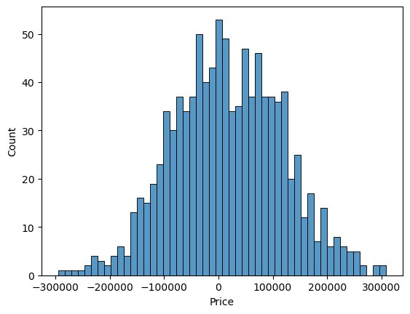
IN[3]:
print(r2_score(Y_test, Prediction1))
print(mean_absolute_error(Y_test, Prediction1))
print(mean_squared_error(Y_test, Prediction1))

Slide 19

OUT[3]:
0.9182928179392918
82295.49779231755
10469084772.975954

